Slide 1
Self-Organizing Networks in LTE:
a Q-learning Approach to ABS Optimization

Slide 2
Self-Organizing Networks (SON)
In 2016, global mobile data traffic amounted to 7 exabytes (EB) per
month;
in 2021, mobile data traffic worldwide is expected to reach 49 EB per month at a compound annual growth rate of 47%;
To keep the pace of this incoming scenario, an efficient solution is needed: exploit heterogeneous networks (HetNet) and make the systems more autonomous and automated;
The concept of Self-Organizing Networks (SON) is a possible approach to achive these goals.

Slide 3
The SON functions are usually categorized into three main groups:
Self-Planning: identify the parameter settings of new network elements;
Self-Deployment: make a “plug and play” approach for each new node;
Self-Healing: execute routine actions that keep the network operational and prevent problems;
Self-Optimization: collect performance indicators from User Equipments (UEs) and the base stations (eNodeB) to auto-tune the network settings.
Our work is focused on the last point of the list, precisely on the improvement of the signal quality and so of the throughput, in a LTE system;
We aim to minimize the interference in a HetNet, made of micro and macro cells, with an adaptive coordination in downlink transmissions of the antennas, controlling the transmit power patterns.

Slide 4
Enhanced Inter Cell Interference Coordination (eICIC)
Micro cells (radius 10-300m) are low power nodes and provide high capacity to UEs. Macro cells (radius up to 20km) are high power nodes with a smaller capacity.
Since they share the same frequencies, the latter severly degredes the downlink transmission of the former and an UE might connect to a macro instead of a micro, because it senses a stronger received power from high-power node.
The solution, implemented in LTE 3GPP standard, is known as enhanced Inter Cell Interference Coordination (eICIC) and macro gets silent for an amount of time called Almost Blank Subframe (ABS).
So the challenge is to find the optimal number and pattern of ABS in a frame to improve the involved system.

Slide 5
Simulations
TRAINING PHASE
40 simulations of 100 frames each
Random users path over a simulated city
Q-learning’s off policy exploitation
Comparisons: 2 different ABS policies implemented in MoNSTER
RANDOM: the number of ABS is increased, decreased or hold with equal probability
STATIC: the number of ABS is kept constant over the entire simulation
Three different traffic model considered
WEB BROWSING: requests are made following a Poisson process of parameter
FULL BUFFER: the system is always saturated with packets of incredible size
VIDEO STREAMING: traffic is generated usingBig Buck Bunny real traces

Slide 6
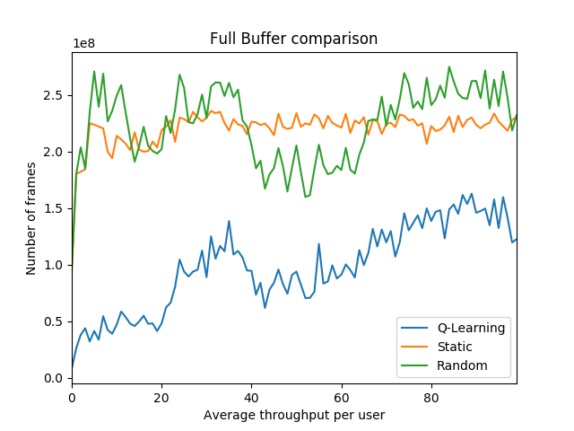
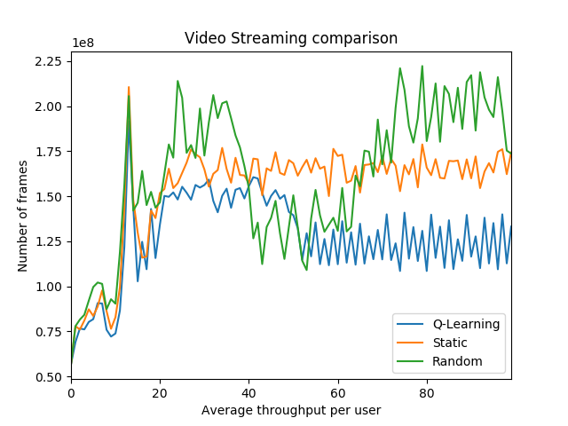
Results (1/2)

Slide 7
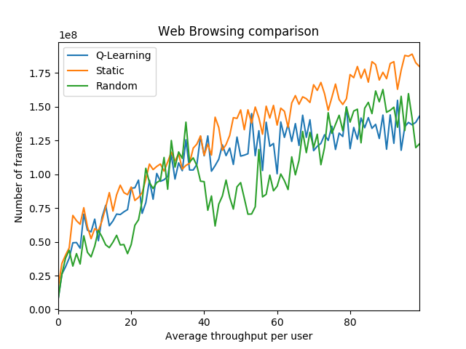
Results (2/2)

Slide 8
Why learning fails: hypothesis
Training set is not enough representative
Computational contraints over the simulated scenario
The choosen state is not representative
The reward doesn’t catch the learning problem
Properly parameter selection

Slide 9
Conclusions and future work
First attempt of ABS optimization
Stranger results
Re-modelization of the problem
Parameter selection
Deep Q-learning

